Slide 1
Photography
Adjunct Professor Brandy Evans

Slide 2
Photography Tips and Tricks
You want your photography to stand out on social media, but that can be a challenge when everyone has the same tools as you do.
Visual content is slowly becoming one of the pillars of most successful social media marketing strategies.
There is science and data to support this.

Slide 3
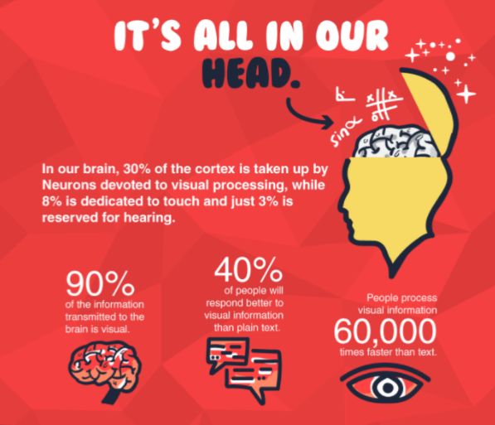

Slide 4
Photography Tips and Tricks
Your marketing efforts are directly influenced by the needs of your audience so your business will need to adopt a different approach.
Hubspot found that Facebook posts with images saw more than twice the engagement than those without images.
Compelling visual content is the solution to standing out in a saturated marketing landscape.
Exceptional social media marketing campaigns should have both curated content and unique content that you’ve produced.

Slide 5
So How Do you Create Compelling Photos With Your Phone?
Lighting and composition dictate the quality of your photos.
Use natural light as often as possible.
If you are indoors, do your best to be near a window and away from artificial light.
Artificial light tints your photos yellow.
Don’t be afraid to take pictures on a cloudy day, the gray weather means that the light spreads out everywhere.
The Rule of Thirds is a way to align your photos so that you create an appealing image.

Slide 6
So How Do you Create Compelling Photos With Your Phone?
There is a grid’s setting on your phone. To turn this on, go into your settings on your iPhone, scroll down to the Camera tab and tap the Grid button.
Center your subject in the center of the grid and play with the placement to see what draws you in.
No matter what kind of content you’re creating, your marketing efforts should always be data driven.

Slide 7
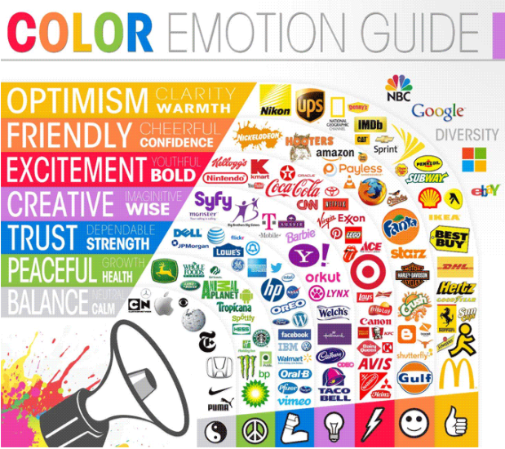

Slide 8
Use Color to Enhance Your Brand
Here are a few tips
A neutral color palette is typically minimalist in nature.
A warm color palette is more inviting.
A cold color palette creates a sense of distance.
Just because you took the picture does not mean you’re work is complete
Photoshop is a more complex tool you can use on your desktop.
If you’re on a budget, Gimp is a free alternative to Photoshop with a nearly identical toolbox.
Mobile photo editing apps may not be as powerful as Photoshop, but they can enhance your photos.

Slide 9
Free Phone Editing Tools
Top app editing tools
Pixlr – easy to use tools, more than 200 overlays for collages, workspace is customizable.
Snapseed – user-friendly interface, at the bottom of the app are around 15 different categories where all the tools are held, simple features included like cropping and straighten tools while others provide a way make manual or automatic color adjustments.
Be Funky – adjust brightness, fill light, contrast, hue, soften, a red-eye remover, lipstick applier, wrinkle remover and teeth whitener tool.
PiZap – crop the image, add an effect, text, stickers, borders, and is well-suited for making memes.

Slide 10
Guest Speaker
Mike Greer, Social Media Coordinator for Caesars Entertainment

